Slide 1
CLASSIFICATION & PREDICTION
Classification:
  predicts categorical class labels
  classifies data (constructs a model) based on the training set and the values (class labels) in a classifying attribute and uses it in classifying new data
  Supervised learning process
Prediction:
  models continuous-valued functions, i.e., predicts unknown or missing values
Typical Applications
  credit approval
  target marketing
  treatment effectiveness analysis

Slide 2
Steps in classification
Model construction: describing a set of predetermined classes
  Each tuple/sample is assumed to belong to a predefined class, as determined by the class label attribute
  The set of tuples used for model construction: training set
  The model is represented as classification rules, decision trees, or mathematical formulae
Model usage: for classifying future or unknown objects
  Estimate accuracy of the model
    The known label of test sample is compared with the classified result from the model
    Accuracy rate is the percentage of test set samples that are correctly classified by the model
    Test set is independent of training set, otherwise over-fitting will occur

Slide 3



Classification Process (1): Model Construction
Classification
Algorithms
Training
Data
Classifier
(Model)
IF rank = ‘professor’
OR years > 6
THEN tenured = ‘yes’

Slide 4




Classification Process (2): Use the Model in Prediction
Classifier
Testing
Data
Unseen Data
(Jeff, Professor, 4)
Tenured?

Slide 5
Issues in classification & prediction
Data cleaning
  Preprocess data in order to reduce noise and handle missing values
Relevance analysis (feature selection)
  Remove the irrelevant or redundant attributes
Data transformation
  Generalize and/or normalize data

Slide 6
Evaluating the classification techniques
Predictive accuracy
  Ability to predict the class label correctly
Speed
  time to construct the model
  time to use the model
Robustness
  handling noise and missing values
Scalability
  efficiency in disk-resident databases
Interpretability
  understanding and insight provided by the model
Goodness of rules
  decision tree size
  compactness of classification rules

Slide 7
Classification by decision tree induction
Decision tree
  A flow-chart-like tree structure
  Internal node denotes a test on an attribute
  Branch represents an outcome of the test
  Leaf nodes represent class labels or class distribution
Decision tree generation consists of two phases
  Tree construction
    At start, all the training examples are at the root
    Partition the examples recursively based on selected attributes

Slide 8
  Tree pruning
    Identify and remove branches that reflect noise or outliers
Use of decision tree: Classifying an unknown sample
  Test the attribute values of the sample against the decision tree

Slide 9
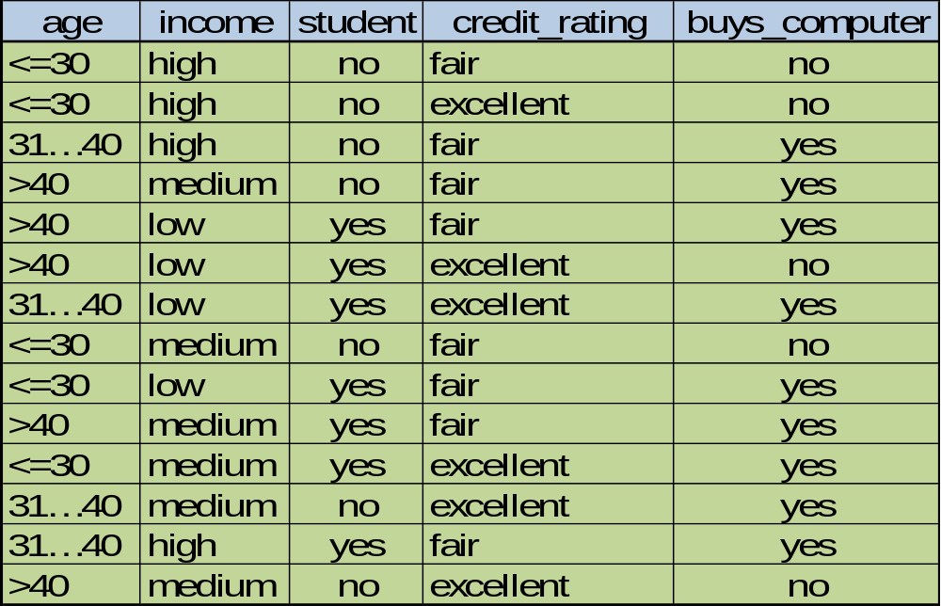
Decision tree induction example

Slide 10
Output: A Decision Tree for “buys-computer”
age?
<=30
>40
30..40
student?
yes
credit rating?
no
yes
excellent
fair
no
yes
no
yes

Slide 11
Decision Tree induction algorithm
Basic algorithm (a greedy algorithm)
  Tree is constructed in a top-down recursive divide-and-conquer manner
  At start, all the training examples are at the root
  Attributes are categorical (if continuous-valued, they are discretized in advance)
  Examples are partitioned recursively based on selected attributes
  Test attributes are selected on the basis of a heuristic or statistical measure (e.g., information gain)

Slide 12
Conditions for stopping partitioning
  All samples for a given node belongs to the same class
  There are no remaining attributes for further partitioning – majority voting is employed for classifying the leaf
  There are no samples left
Attribute selection methods
  Information gain
  Gain ratio
  Gini index

Slide 13
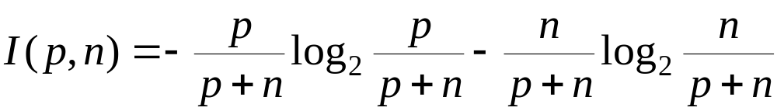
Information gain (ID3)
  All attributes are assumed to be categorical
  Can be modified for continuous-valued attributes
  Select the attribute with the highest information gain
  Assume there are two classes, P and N
  Let the set of examples S contain p elements of class P and n elements of class N
  The amount of information, needed to decide if an arbitrary example in S belongs to P or N is defined as

Slide 14
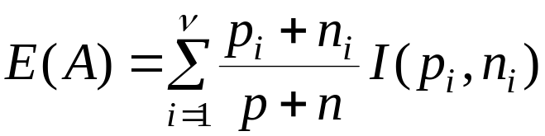

Assume that using attribute A, a set S will be partitioned into sets {S₁, S₂ , …, S_{v}}
  If S_{i} contains p_{i} examples of P and n_{i} examples of N, the entropy, or the expected information needed to classify objects in all sub trees S_{i} is
The encoding information that would be gained by branching on A

Slide 15
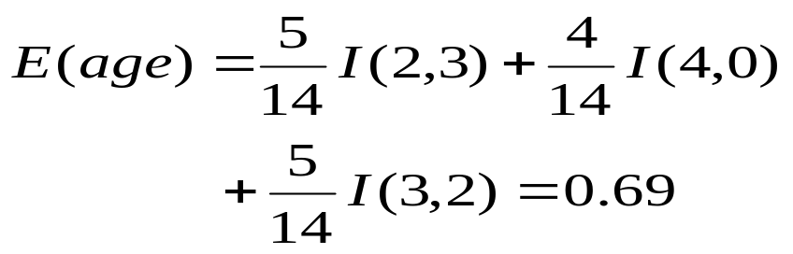


Class P: buys_computer = “yes”
Class N: buys_computer = “no”
I(p, n) = I(9, 5) =0.940
Compute the entropy for age:
Hence
Similarly

Slide 16
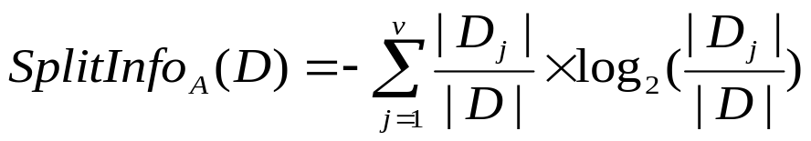
Gain ratio for attribute selection (C4.5)
Information gain measure is biased towards attributes with a large number of values
C4.5 (a successor of ID3) uses gain ratio to overcome the problem (normalization to information gain)
  GainRatio(A) = Gain(A)/SplitInfo(A)
Ex.
  gain_ratio(income) = 0.029/0.926 = 0.031
The attribute with the maximum gain ratio is selected as the splitting attribute

Slide 17


Gini index (CART)
If a data set D contains examples from n classes, gini index, gini(D) is defined as
where p_{j} is the relative frequency of class j in D
If a data set D is split on A into two subsets D₁ and D₂, the gini index gini(D) is defined as
Reduction in Impurity:
The attribute provides the smallest gini_{split}(D) (or the largest reduction in impurity) is chosen to split the node (need to enumerate all the possible splitting points for each attribute)

Slide 18
Tree Pruning
Helps to remove the branches which reflects the
  Noise
  Errors
Uses the statistical measures to identify the least reliable branches
Characteristics of pruned tree
  Easy to understand
  Less complex
  Small in size

Slide 19
Types of pruning
Pre-pruning
  Tree gets pruned by halting the construction process at early stages
  Leaf node gets introduced during the halt.
  Halt criteria
    If the partition process results in a set of values for the statistical measures fall below the threshold value
contd…

Slide 20
Post-pruning
  Subtree gets removed at later stage
  Associated branches, nodes also gets discarded
  Cost complexity gets compared for pruned & unpruned trees

Slide 21
Bayesian classification
Is a statistical classifier
Predicts the class label by calculating the membership probabilities
Naïve bayesian classifier is a simple bayesian classifier
Works based on Bayes Theorem
Uses the class conditional independence

Slide 22
Bayes Theorem
Introduced by Thomas Bayes
Let
  X be a tuple/evidence
  X gets described by n attributes values
  H be the hypothesis
    Data tuple X belongs to the specified class C_{i}
Need to determine P(H|X) → Probability the hypothesis H holds the tuple X
P(H|X) – Posterior/posteriori probability

Slide 23

P(H) – Prior/Apriori probability of H
Prior probability is independent of any attributes
P(X|H) – Posterior probability of X conditioned on H.
P(X) – prior probability for X
Need to calculate all the above mentioned values
Calculate the value for all the classes, select the class which has the largest value

Slide 24
Naïve Bayesian Classification
Let
  D be a training data tuples, class labels
  X gets described by n attributes values
  A₁,A₂,…..A_{n} are the values for the tuple
Let
  m classes C₁,C₂,…..C_{m}
  X be the given tuple
Classifier assigns a class label which have highest posterior probability conditioned on X

Slide 25
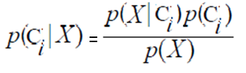
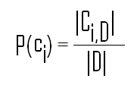
P(C_{i}|X) > P(C_{j}|X) for 1 ≤ j ≤ m, j ≠ i
The class which has maximum value is said to be ”maximum posteriori hypothesis”
P(X) constant for all the classes
Numerator alone need to be maximized
Class probability can be computed using

Slide 26

we can easily compute the value for the terms in the above equation
let x_{k} be the value for an attribute A_{k} for the tuple X
If A_{k} is a categorical value then
P(x_{k}|C_{i}) is the # of tuples in C_{i} having value x_{k} for A_{k} divided by |C_{i, D}| (# of tuples of C_{i} in D)
If A_{k} is a Continuous value then
  P(x_{k}|C_{i}) is usually computed based on Gaussian distribution with a mean μ and standard deviation σ

Slide 27


we need to compute the last two parameters which are the mean and standard deviation for the tuples in a class C_{i} for an attribute A_{k}
Calculate the probability for each class, select the class label for which we got a highest value.

Slide 28
Case study
using the previous example, predict the class label for a tuple
X={age=youth, income=medium, student=yes, credit-rating=fair}
let buys-computer is a class label
C1= set of tuples belongs to a class buys computer=yes
C2=set of tuples belongs to a class buys computer=no

Slide 29
Bayesian Belief Networks
Also called as belief networks, bayesian networks, probabilistic networks
Limitations of naïve bayesian classifier
  Assumes the class conditional independence
    Simplifies the computation
    Suitable if the assumption holds true
Dependency exists between the variables
BBN specifies the joint conditional probability distributions
  Class conditional dependencies between the subset of attributes

Slide 30
Provides a graphical model to represent the causal relationships
Defined by two components
  Directed Acyclic Graph (DAG)
  Set of conditional probability table (CPT)
DAG
  Collection of nodes
  Node represents a random variable
  Variables
    Continuous or discrete
    Actual variables or hidden variables believed to form a relationship
  Nodes are connected through arcs
  Arcs represents a probabilistic dependence

Slide 31
If there is an arc from node y to node z then
  Y is a parent (immediate predecessor) for Z
  Z is a descendant for Y
  Given a node parents, every variable is conditionally independent of its non descendants in the graph
  Simple BBN with six Boolean variables
FamilyHistory
Smoker
LungCancer
Emphysema
PositiveXRay
Dyspnea

Slide 32
Lung cancer is influenced by family history of lung cancer as well as whether or not a person is smoker
Variable positive-x-ray is independent of whether the patient has the family history of lung cancer or is a smoker
Variable lung cancer is conditionally independent of emphysema, given its parents family history, smoker
Conditional Probability Table (CPT)
  Need to be constructed for every variable Y
  Specifies the conditional distribution P(Y|Parents(Y))
    Parents(Y) is the parents of Y
    Conditional probability for each value of Y for each possible combination of values of its parents

Slide 33
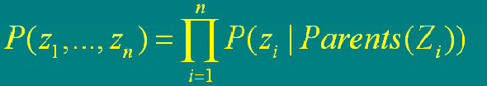
for node LungCancer we may have
P(LungCancer = “True” | FamilyHistory = “True” ∧Smoker = “True”) = 0.8 P(LungCancer = “False”| FamilyHistory = “False” ∧Smoker = “False”) = 0.9
…
The joint probability of any tuple (z₁,…, z_{n}) corresponding to variables Z1,…,Zn
Where P(z₁,….z_{n}) is the probability of a particular combination of values of Z, and the values P(z_{i}|Parents(Z_{i})) corresponds to the entries in CPT
A node can be selected as a “output” node represents the class label attribute
Learning algorithms return the probability rather than class label

Slide 34
Prediction
Process of predicting the continuous values rather than a categorical values
Example
  Predicting the salary for a person with 20 years of experience
Regression is the most widely used approach
  Introduced by sir frances galton
  Used to model the relationship between one/more
    Predictor variables and response variables
In data mining
  Predictor variables are attributes of interest
  Response variable is what to predict

Slide 35
Problems can be solved by linear regression by converting it to linear regression model
Some of packages solves the regression problems
  SAS – www.sas.com
  SPSS – www.spss.com
Linear Regression
  Involves a response variable y and single predictor variable x
  It models y as a linear function of x
    y = b + wx
    where b, w are regression coefficients

Slide 36
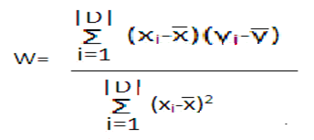

b, w are solved using method of least squares
Let
  D is the set of training set of tuples
  |D| is the total no. of tuples
Training data tuples converted into data points (x₁,y₁),(x₂,y₂),……..(x_{|D|},y_{|D|})
Where , are the mean for an attribute x, y

Slide 37
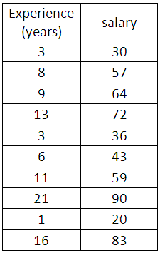
Case study
using the table given below predict the response variable value for an predictor variable value 10 years experience

